Slide 1
1) Cover Slide
Title: Sentiment Analysis of Amazon Reviews Using Machine Learning and NLP Techniques
Subtitle: Leveraging Data Science for Insights and Decision Making
Your Name: [Your Name]
Date: [Date of Presentation]

Slide 2
2) Overview
Introduction to the Project:
Our project primarily focuses on sentiment analysis, by using Natural Language Processing (NLP) that is used for understanding emotions expressed in textual data. Using machine learning techniques, we aim to analyze the sentiment of Amazon reviews.
The project provides various functionalities, including:
Input Text Sentiment Analysis: Users can input text directly into the application for sentiment analysis.
Speech Input: The application allows users to speak and convert their speech into text for sentiment analysis.
CSV File Upload: Users can upload CSV files containing reviews, and the application will predict the sentiment of each review using our NLP model.
By leveraging NLP models and machine learning algorithms, we can classify the sentiment of reviews into categories such as Positive, Negative, or Neutral. This analysis helps businesses gain insights into customer opinions, product satisfaction levels, and overall sentiment trends.

Slide 3
Importance of Sentiment Analysis:
By using sentiment analysis, we can understand the customer opinions and improve our business decisions.
We can use this web app for customer feedback analysis, market research, and brand perception management.

Slide 4
3) Aims and Objectives
Objective:
Develop a robust sentiment analysis model for Amazon reviews using a machine learning pipeline.
Aim:
Utilize NLP techniques and machine learning model to extract actionable insights from textual data and improve decision-making processes.

Slide 5
4) Problem Statement
Challenges in Sentiment Analysis:
Handling Unstructured Text Data:
We get the HTML tags, punctuation, digits, and symbols in reviews. It needs to clean data before use.
Model Selection and Training:
We use Naive Bayes Model, Logistic Regression Model with using the feature engineering with Count Vectorization and TF-IDF Vectorization for selecting and training ML models for sentiment classification.
Evaluation and Interpretation:
We use the Hyperparameters for Address the accuracy metrics, model interpretability, and business implications.

Slide 6
5) Contribution Table
Cleaning Data: I made sure our data was good to go by removing any duplicate, filling in missing parts, and making sure all the text looked the same.
Choosing Models: I picked Logistic Regression Model with TF-IDF Vectorization as it has higher accuracy after hyperparameter.
Making the Web app: I built a web page by using the streamlit library.
Sharing Results: I made a presentation to share what we did, how we did it, and what we found out.

Slide 7
6) Risk Assessment Table
Identify Potential Risks:
There is the risk of model overfitting, underfitting, and model stability over time.
Some time it gives wrong prediction after getting good accuracy, so we did the hyper tuning of model.

Slide 8
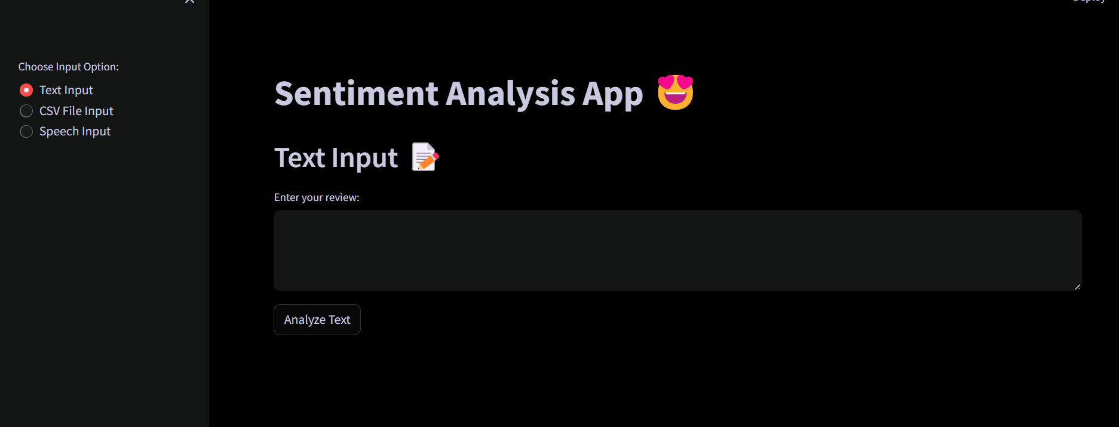
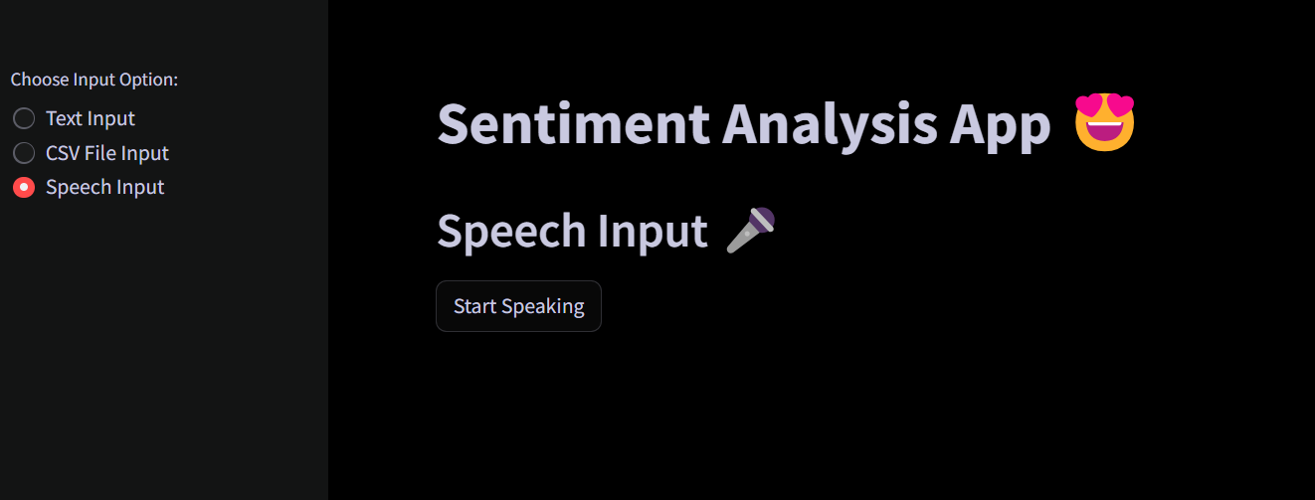
7) Screenshots of MS Project

Slide 9
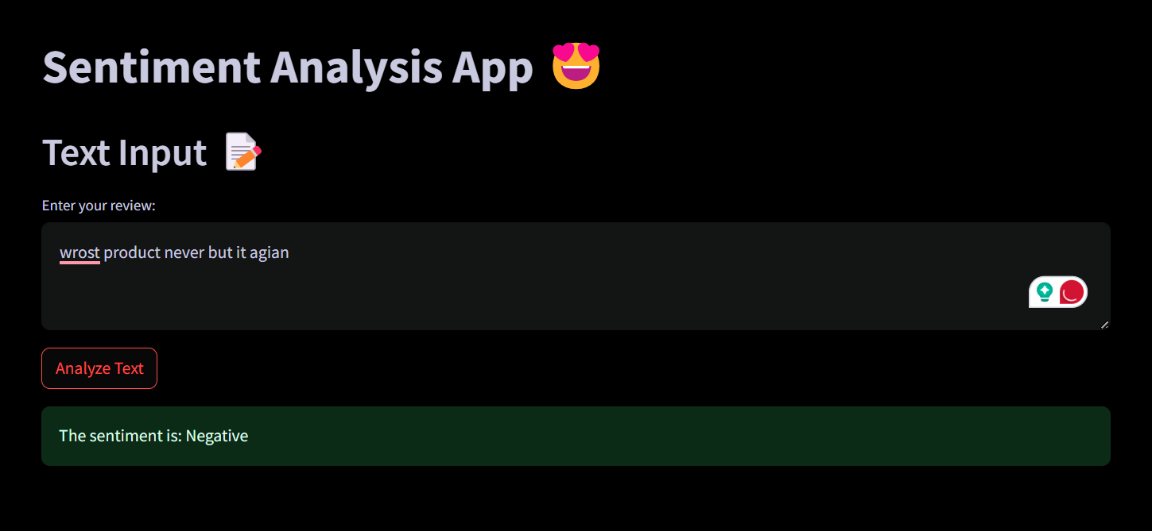
8) Demo

Slide 10
9) Scrum Planning (3)
Agile Methodology:
We use the Agile Methodology means we work step by step, doing a little bit at a time and often checking to see if everything is going well. We focus on teamwork and being flexible to changes as needed.
Sprint Breakdown:
Sprint 1 (Data Preprocessing):
Here, we clean up the data, fix any errors, and prepare it for analysis.
Sprint 2 (Model Selection):
We choose the best machine learning models for our project, teach this model with the cleaned-up data.
Sprint 3 (Web App Development):
In this phase, we build our web app by using streamlit, where people can input text, upload files, and get feedback on sentiment. It's like creating a tool that anyone can use easily.

Slide 11
10) Data Sets
Amazon Reviews Dataset:
Source: Kaggle dataset containing Amazon reviews data.
https://www.kaggle.com/datasets/jagdishchavan/amazon-reviews
Features: We are using the Text and Score features of the data set.

Slide 12
11) References
Tools and Resources Used:
Goolge Colab for model building.
Python Libraries: Pandas, NumPy, NLTK, Scikit-learn, Streamlit, Pyngrok, matplotlib, seaborn, wordcloud , pydub SpeechRecognition,ffmpeg, PyAudio
Kaggle Dataset

Slide 13
12) Conclusions
Key Findings and Outcomes:
Logistic Regression and Naive Bayes, combined with TF-IDF Vectorization, achieved a good level of accuracy in predicting sentiment, ensuring reliable results.
By doing the EDA Data Exploration we get the insights from data analysis (word cloud, sentiment distribution).

Slide 14
13) NLP Improvements
Future Enhancements:
We can explore the advanced NLP Models like BERT and LSTM for sentiment analysis.
We can fine-tune the model for specific domains to improve sentiment analysis accuracy.

Slide 15
14) Test Plan
Testing Strategies:
We Test data preprocessing functions, model evaluation, and web app functionality step by step.
We will Gather feedback during the demo phase and ensure application reliability.

Slide 16
15) Thank You Slide
Acknowledgment:
Thank team members and mentors for their contributions and support.

